Slide 1
Designing Websites
Building Personal Websites
Lecture 02 | Designing Websites

Slide 2
Introduction to Design
Wireframing
Page Linking
Softwares for Design
Building Personal Websites
Lecture 02 | Designing Websites

Slide 3
What is Design?
de·sign
noun
a plan or drawing produced to show the look and function or workings of a building, garment, or other object before it is built or made.
Building Personal Websites
Lecture 02 | Designing Websites

Slide 4
Okay, great. But what is Design for Websites?
web de·sign
noun
a plan or drawing produced to show the look and function or workings of a website before it is built or made.
Building Personal Websites
Lecture 02 | Designing Websites

Slide 5
Look
Is it appealing?
Are images and text clean and readable?
Does it grab the eye?
Does it make good use of form and color?
Is there a level of consistency between pages and objects?
Function
Does it have the right information?
Is nothing being obstructed?
Can a user find their way around the site?
Building Personal Websites
Lecture 02 | Designing Websites

Slide 6
*Assuming pirates have wifi
Your Site
Clients enter the site having something the want to learn or see in mind.
Your site needs to supply that in a quick and visually-impressive matter.
Building Personal Websites
Lecture 02 | Designing Websites

Slide 7
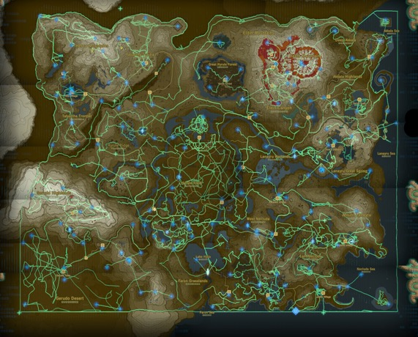
*Assuming pirates have wifi
Websites are like treasure maps!
Helps clients get their gold.
Building Personal Websites
Lecture 02 | Designing Websites

Slide 8
Introduction to Design
Wireframing
Page Linking
Softwares for Design
Building Personal Websites
Lecture 02 | Designing Websites

Slide 9
What You Need To Design A Website
Building Personal Websites
Lecture 02 | Designing Websites

Slide 10
This is known as a Website Wireframe.
Constructs frames for the content without including any of the actual content.
Benefits
Fast and easy to sketch.
Reusable for multiple sources.
Makes web development 100000x easier
Building Personal Websites
Lecture 02 | Designing Websites

Slide 11
How to tell if a Wireframe is successful:
Can you identify what each frame represents?
Do no frames overlap?
Is there ample space between all frames?
Is no frame too small to be visible?
If you answered yes to all of these, chances are it’s a successful wireframe.
The goal of a wireframe is to identify transformation properties of the content relative to one another.
Building Personal Websites
Lecture 02 | Designing Websites

Slide 12
Common References
Images
Text (body)
Important text fields (titles, labels) will be explicitly written and in larger fonts
Button
Input Fields
Building Personal Websites
Lecture 02 | Designing Websites

Slide 13
Steps to Designing a Wireframe
Step 1: Determine what it is you are building.
Is it a personal website? A commercial outlet? Maybe a campaigning website?
Who is your audience? Little kids? Business professionals? Students looking up past lectures and course notes?
Building Personal Websites
Lecture 02 | Designing Websites

Slide 14
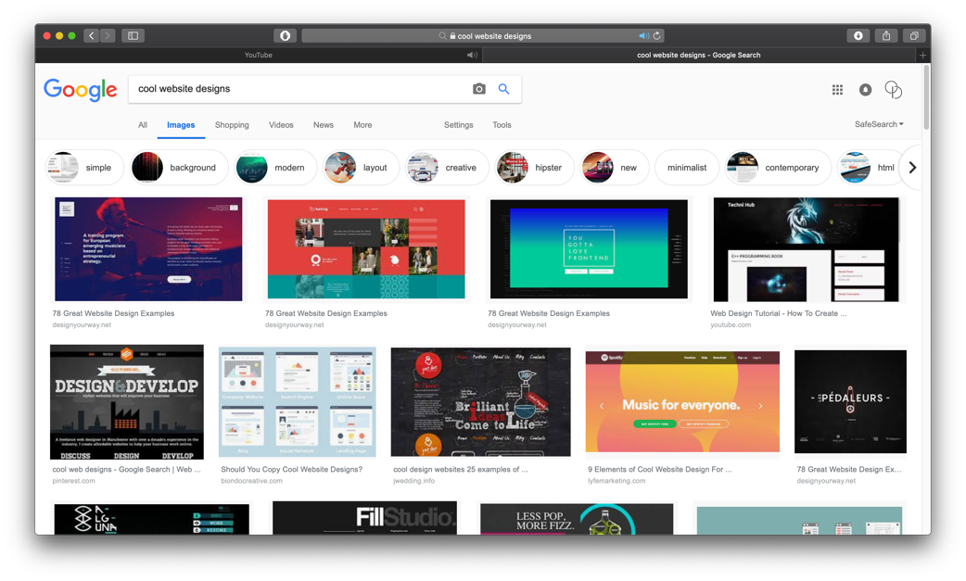
Steps to Designing a Wireframe
Step 2: Look for inspiration.
This is not cheating. Keep tabs of what you like about certain sites.
Building Personal Websites
Lecture 02 | Designing Websites

Slide 15
Steps to Designing a Wireframe
Step 3: Rough Sketches
Using references from the previous part, start laying out a rough sketch of your website. Keep in mind that almost all websites have the following components:
Building Personal Websites
Lecture 02 | Designing Websites

Slide 16
Steps to Designing a Wireframe
Step 4: Content Features
Break rough sketches into more discrete components. Label areas where you want to place images, text, videos, & link.
Remember that a website is a map for information. Making your information easy to find and interact with should be top priority. Consider aligning similar elements together and placing dividers and spaces between different elements.
Building Personal Websites
Lecture 02 | Designing Websites

Slide 17
Introduction to Design
Wireframing
Page Linking
Softwares for Design
Building Personal Websites
Lecture 02 | Designing Websites

Slide 18
Websites allow for near-infinite display and storage of information.
While there is no limit on how much content you can include on your site, rarely do people choose to include all their info on one page.
Websites allow creators to separate their content by webpage in order for easier access.
If a user wants to find a list of your skills, it is easier to have a navbar with webpage links (one labeled skills) that having to scroll through the entire site.
Building Personal Websites
Lecture 02 | Designing Websites

Slide 19

What subpages could we have if we were building a site for this resume?
Building Personal Websites
Lecture 02 | Designing Websites

Slide 20
Home | Experience | Skills | Awards | Courses
John Doe
Business Developer Manager
Building Personal Websites
Lecture 02 | Designing Websites

Slide 21
Building Personal Websites
Lecture 02 | Designing Websites

Slide 22
Home | Work | Experience | Skills
Home | Work | Experience | Skills
Home | Work | Experience | Skills
Home | Work | Experience | Skills
Building Personal Websites
Lecture 02 | Designing Websites

Slide 23
Home | Work | Experience | Skills
Home | Work | Experience | Skills
Home | Work | Experience | Skills
Home | Work | Experience | Skills
(can get messy quickly)
Building Personal Websites
Lecture 02 | Designing Websites

Slide 24
Introduction to Design
Wireframing
Page Linking
Softwares for Design
Building Personal Websites
Lecture 02 | Designing Websites

Slide 25


Steps to Designing a Wireframe
Step 5: Rendering on a Digital Platform (Beyond Scope of Course)
Reconstructing wireframe in an illustration or design-oriented software.
Allows for more accurate placement of elements with the flexibility of moving them around later.
Freely experiment with color.
*Can also be done in PowerPoint!
Building Personal Websites
Lecture 02 | Designing Websites

Slide 26
Steps to Designing a Wireframe
Step 5: Rendering on a Digital Platform (Beyond Scope of Course)
Building Personal Websites
Lecture 02 | Designing Websites

Slide 27
Homework Ideas
Create rough sketches of site on paper.
Separate content onto different pages.
Link pages together using arrows.
Specify what type of content goes where (paragraph, image, etc).
Email sketches of site to Andrew ID odadfar
Building Personal Websites
Lecture 02 | Designing Websites

Slide 28
Live Demo
Building Personal Websites
Lecture 02 | Designing Websites

